Slide 1
Disaster Recovery with Azure Kubernetes Service
Subtitle or speaker name
Notes:
Welcome to Disaster Recovery with Azure Kubernetes Service.
My name is [Speaker name].

Slide 2
Agenda
Node availability
Multi-region deployments
Network-close images

Slide 3
Node availability

Slide 4
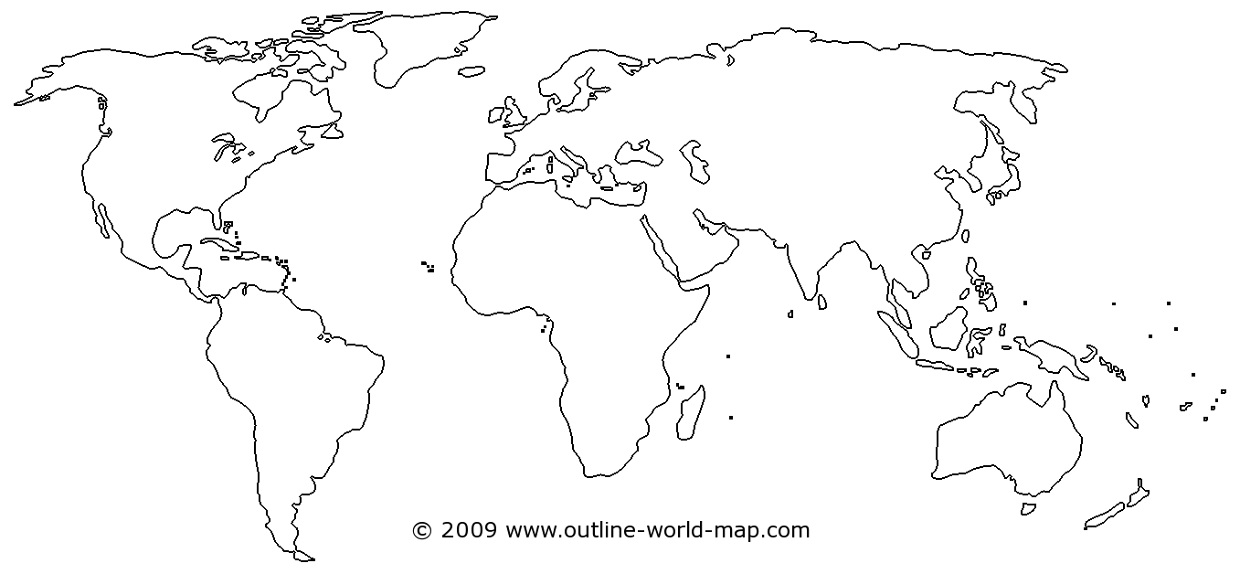
Availability Zones
Region*
AKS AZs
Region*
AKS AZs
Region*
AKS AZs
Notes:
As you know, zones offer protection from datacenter failures in region by deploying resources to unique physical locations within region. Each zone is made up of one or more datacenters equipped with independent power, cooling, and networking. To ensure resiliency, there's a minimum of three separate zones in all zone enabled regions.
AKS distributes your resources such as nodes and their associated storage through the Azure fabric using Virtual Machine Scale Sets and being that AKS is built on top of virtual machines we can take advantage of features such as Availability Zones. The introduction of availability zone support for AKS allows you to distribute your cluster nodes across 1 or more availability zones at the time a cluster is created.
<click>

Slide 5
Availability Zones
1
Resiliency to datacenter failures
2
Nodes are split across 3 datacenters in a region
3
Gives us fault domains to plan our deployments around
4
Manually bring failed nodes back to your cluster
Notes:
When you create a cluster using the az aks create command, the --zones parameter defines which zones agent nodes are deployed into. The control plane components such as etcd is spread across three zones if you define the --zones parameter at cluster creation time. The specific zones which the control plane components are spread across are independent of what explicit zones are selected for the initial node pool.
If you don't define any zones for the default agent pool when you create an AKS cluster, control plane components are not guaranteed to spread across availability zones. You can add additional node pools using the az aks nodepool add command and specify --zones for new nodes, but it will not change how the control plane has been spread across zones.

Slide 6
Deploying AKS components with AZs
az group create --name clusterRG --location eastus2
# Create a cluster with zonal support
az aks create \
--resource-group clusterRG \
--name aksCluster \
--generate-ssh-keys \
--vm-set-type VirtualMachineScaleSets \
--load-balancer-sku standard \
--node-count 7 \
--zones 1 2 3
az aks nodepool add \
--cluster-name aksCluster \
--name zonalpool \
--resource-group clusterRG \
--mode User \
--node-count 2 \
--zones 1 3 \
Notes:
Walk through the two examples…
When deciding what zone a new node should belong to, a given AKS node pool will use a best effort zone balancing offered by underlying Azure Virtual Machine Scale Sets. A given AKS node pool is considered "balanced" if each zone has the same number of VMs or +- 1 VM in all other zones for the scale set.
With best-effort zone balance, the scale set attempts to scale in and out while maintaining balance. However, if for some reason this is not possible (for example, if one zone goes down, the scale set cannot create a new VM in that zone), the scale set allows temporary imbalance to successfully scale in or out. On subsequent scale-out attempts, the scale set adds VMs to zones that need more VMs for the scale set to be balanced. Similarly, on subsequent scale in attempts, the scale set removes VMs from zones that need fewer VMs for the scale set to be balanced.

Slide 7
Target AZs using affinity
affinity:
nodeAffinity:
requiredDuringSchedulingIgnoredDuringExecution:
nodeSelectorTerms:
- matchExpressions:
- key: failure-domain.beta.kubernetes.io/zone
operator: In
values:
- eastus2-1
- eastus2-3
Notes:
Node affinity (not to be confused with NodeSelector) is a method which we can use to constrain our pods to select nodes within our cluster by defining affinity in our pod spec. Say we deploy a cluster with 3 nodes – 1 in each zone, but then we deploy a small application with a single replica and we always want it to land in Zone 1 so it can use a persistent volume attached to a managed disk in the same zone.
To do this, we'll leverage nodeAffinity of which there are two types available – requiredDuringSchedulingIgnoredDuringExecution and preferredDuringSchedulingIgnoredDuringExecution. If you pod needs to land on designated zones, use required – if the pod can't be scheduled it won't be deployed. preferredDuringSchedulingIgnoredDuringExecution allows you to scheduled the pod even if the designed node with the labels you desire isn't available.
Different vendors use different node labels – Microsoft uses failure-domain.beta.kubernetes.io/zone today to show which region and zone a node are a member of. Using matchExpressions, you can target your pods to one or more zones that your nodes run on.
The same label, failure-domain.beta.kubernetes.io/zone, is also used on PersisentVolumes in addition to nodes.

Slide 8
Demo
Verifying node distribution
Notes:
Let's take a look at a running cluster with a few node pools distributed across zones.
https://github.com/opsgility/virtual-partner-bootcamp/blob/master/Azure%20Infrastructure/Day%204%20-%20AKS/Disaster%20Recovery%20with%20Azure%20Kubernetes%20Service/Disaster%20Recovery%20with%20Azure%20Kubernetes%20Service.md#demo-verifying-node-distribution

Slide 9
Limitations
Regions
Limited regional support
VM SKU
Must be available across all zones selected
Load balancers
Disks
Stateful applications?
YANC…
Notes:
There are limitations to Availability Zones in AKS that you should be aware of.
The first is limited regional support. As of today, the ability to deploy an AKS cluster with zonal support is not available in all of the regions where AKS is available, even if that region supports zones. You should refer to the docs for the most up to date information, but for today, AKS w/ zones is limited to:
Central US
East US 2
East US
France Central
Japan East
North Europe
Southeast Asia
UK South
West Europe
West US 2
Next up, be aware that the VM SKU you select for use in your cluster or pool nodes needs to be available in all zones. It doesn't often happen that this isn't the case, but if you're using a specialized VM series it is something to watch out for.
Clusters with availability zones enabled also require the use of Azure Standard Load Balancers for distribution across zones. This load balancer type is the default and can only be defined at cluster create time.
Azure managed disks are also not zone-redundant resources. Volumes cannot be attached across zones and must be co-located in the same zone as a given node hosting the target pod created from your spec. If you are deploying stateful applications, use node pool taints and tolerations in pod specs to group pod scheduling in the same zone as your disks. Alternatively, you can use network-based storage such as Azure Files that can attach to pods as they're scheduled between zones.
And remember YANC, or Yet Another New Cluster – zones, VM scale sets, standard balancers, etc. all require the creation of a new cluster and cannot be enabled in existing clusters.

Slide 10
Handling Application Failure
1
Use deployments with replication set to the number of zones you are using
2
Use an ingress controller that is highly available
3
Understand your disk mounts in pods
Notes:
Here are some ways to think about limiting transient failures if your applications deployed on AKS when you're using Availability zones.
First, as you saw in the demo, use deployments with the number of replicas set to the number of zones in a given pool, AKS does a decent job of spreading replicas evenly, especially if CPU and memory consumption across nodes is fairly even. And remember, if needed you can create different node pools with different node counts and zone configurations as you start to run up the number of workloads on your clusters.
Second, use ingress controllers that are highly available. This may mean using an ingress controller that is internal to your cluster such as nginx, Istio, Traefik, or HAProxy ingress running on pods in your cluster that are dependent on just node availability. Another ingress controller you might want to consider is the Application Gateway Ingress Controller, of AGIC. The AGIC is an ingress controller which runs within your cluster but externalizes load balancing to Application Gateway. Outside of being able to leverage features of Application Gateway such as the Web Application Firewall, its also possible to use AGIC to control routing of HTTP traffic to multiple AKS clusters. AGIC also eliminates the need to have another load balancer or PIP in front of your AKS cluster and communicates with pods over their private IP directly.
And for disk mounts – tread carefully. Volumes cannot be mounted across zones. This means if the Zone with your pod does go down, there's not a way to schedule the pod in a new zone. You'll end up creating a new volume or restoring an existing volume from a snapshot before you'll be able to schedule the pod successfully.

Slide 11
Multi-region deployments
Notes:
That takes us through single region. Now let's talk multi-region. To be honest, there's not a lot that changes here beyond what we would do for a non-containerized workload. We'll need to find a way to distribute traffic for our application between regions and we'll need to think about the types of workloads we run and whether or not they're suited for multi-region deployment today (for example, stateful vs non-stateful requirements).

Slide 12
The simple things…
AKS regional availability
Paired regions
Service availability
Notes:
Let's get the simple things out of the way first.
Of course, if you're going to go multi-regional, one of the first things you need to do is narrow down the regions you're going to deploy to based on where AKS is available, followed they by the VM SKU(s) you want to use, and then features like Availability zones within those regions. And if you go with AZs don't forget to check and make the VM SKU you select is available in all zones.
Next up, the recommendation for if you are staying in a given geography is to consider paired regions. Paired regions won't help much for automated regional failover, but platform updates are coordinated between paired regions and you'll know if I region does go down how Azure is prioritizing recovery on their end.
Finally, consider service availability – You need to decide whether your paired regions should be hot/hot, hot/warm, or hot/cold. Do you want to run both regions at the same time, with one region ready to start serving traffic? Or do you want one region to have time to get ready to serve traffic?

Slide 13



Routing
Traffic Manager
Azure Front Door
Application Gateway

Slide 14
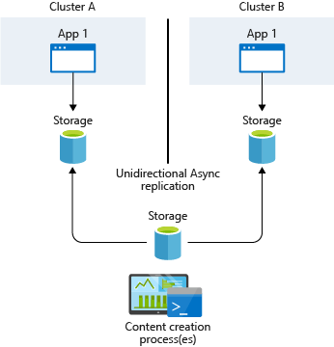
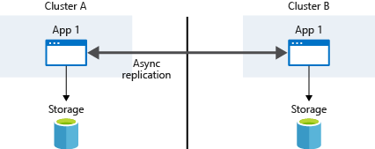
State management
Infrastructure-based replication
Managed disks
Storage replication
Application-based replication
Notes:
Where possible, don't store service state inside the container. Instead, use an Azure platform as a service (PaaS) that supports multi-region replication.
State can be either externalized or co-located with the code that manipulates the state. Typically, you externalize state by using a database or other data store that runs on different machines over the network or that runs out of process on the same machine.
Containers and microservices are most resilient when the processes that run inside them don't retain state. Because applications almost always contain some state, use a PaaS solution such as Azure Database for MySQL, Azure Database for PostgreSQL, or Azure SQL Database.
If you can't externalize state from the cluster, then you're probably dealing with managed disks and storage replication. Because your applications are spread across multiple AKS clusters in different regions, you need to keep the storage synchronized.
Persistent volumes are mounted to a node VM and then exposed to the pods. Persistent volumes follow pods even if the pods are moved to a different node inside the same cluster.
The replication strategy you use depends on your storage solution. Common storage solutions such as Gluster, Ceph, Rook, and Portworx provide their own guidance about disaster recovery and replication.
The typical strategy is to provide a common storage point where applications can write their data. This data is then replicated across regions and then accessed locally. If you do use managed disks, you can go with Kubernetes native solutions such as Heptio or VMware Velero to backup your data and sync it elsewhere or you can use something external to Kubernetes such as Storage Snapshots.
For application-based replication, Kubernetes currently provides no native implementation for application-based asynchronous replication. Because containers and Kubernetes are loosely coupled, any traditional application or language approach should work. Typically, the applications themselves replicate the storage requests, which are then written to each cluster's underlying data storage.

Slide 15
Demo
Backup and restore with Velero
Notes:
Let's take a look at how an application can be backed up and restored with Velero.
https://github.com/opsgility/virtual-partner-bootcamp/blob/master/Azure%20Infrastructure/Day%204%20-%20AKS/Disaster%20Recovery%20with%20Azure%20Kubernetes%20Service/Disaster%20Recovery%20with%20Azure%20Kubernetes%20Service.md#demo-backup-and-restore-with-velero

Slide 16
Network-close images
Notes:
And let's close out with how to bring your images closer to your clusters using Azure Container Registry.

Slide 17
ACR geo-replication
Single registry across multiple regions
Repositories, images, and tags
Single management for IAM
Single URI for image push and pull
Network close registry
Lower latency
Lower egress costs
Requires ACR Premium SKU
Notes:
As a best practice, placing a container registry in each region where images are run allows network-close operations, enabling fast, reliable image layer transfers. Geo-replication enables an Azure container registry to function as a single registry, serving multiple regions with multi-master regional registries.
If you think about the number of times you pull images from your registry, it can be advantageous to have your registry as close as possible to lower both latency and network egress costs. Clients push and pull images from the closest replica. In the background, Azure is using Traffic Manager to determine which region is closest to the client performing the push or pull based on network latency. This can lead to issues, particularly with push operations from Linux clients, especially if your replicas are in regions close to the client. For example, I'm in Florida which is on the East coast of the United States. If I create a Premium registry and enable replicas in both East US and East US 2, there's the potential that when my client pushes it may not push all of the image layers and manifest to a single replicated region as Traffic Manager could connect me to both regional replicas during the push operation. This will cause the push operation to fail when the manifest is validated. This occurs because of the way DNS resolution is performed on Linux hosts and configuration of the client-side DNS cache. To ensure consistent pushes from Linux hosts, you should install client-side DNS cache such as dnsmasq or update DNS retry logic in the target OS.
Geo-replication with Azure Container Registry does require the Premium SKU of the service. Note that you can change from Basic or Standard to Premium at any time.

Slide 18
Demo
Azure Container Registry geo-replication
Notes:
Let's take a look at standing up a geo-replicated registry.
https://github.com/opsgility/virtual-partner-bootcamp/blob/master/Azure%20Infrastructure/Day%204%20-%20AKS/Disaster%20Recovery%20with%20Azure%20Kubernetes%20Service/Disaster%20Recovery%20with%20Azure%20Kubernetes%20Service.md#demo-azure-container-registry-geo-replication

Slide 19
Thank you.
Notes:
Thanks for listening to Disaster Recovery with Azure Kubernetes Service.
My name is [Speaker name].

